Slide 1

"Unveiling the Trends of Music Popularity: Analyzing Spotify Data"
-Quirkey Quartet-
Eric Wang, Luwei Zeng, Jiatong Zhou, Bingquan Zhang

Slide 2
Introduction

Slide 3
Introduction to the Streaming Music Industry
The music industry has been revolutionized by streaming platforms.
Spotify: A leader with 615 million monthly active users (April 2024).
Provides seamless access to millions of songs globally.
Offers unique data insights into music consumption and popularity.

Slide 4

Understanding Music Popularity on Spotify
Explore sentiment of lyrics by genres using Natural Language Processing(NLP).
Analyze song characteristics influencing popularity.
Correlate features with popularity (measured by streaming counts).

Slide 5
Aims and Methodology

Slide 6


Aim 1.1: Collect and Relate Lyrics to Genre Information
Get Lyrics & Genre Data
Use Spotify Web API to retrieve song metadata including genre information.
Use Genius API to collect lyric content according to the song list.
Clean and tokenize the lyric data to link it with songs' metadata respectively.

Slide 7
Aim 1.2: Analyze Sentiment by Genre - NLP
Sentiment Analysis
Prepare lyric tokens by genre for further NLP . (categorization, tokenization , removing stop words)
Use NRC Word-Emotion Association Lexicon to generate emotion scores for each genre.
Visualization
Word Cloud for top emotion by genre.
Pie Chart for emotion distributions.
R&B
POP
RAP

Slide 8
Aim 2.1: Analyzing Musical Features and Popularity
Correlation Analysis
Investigate correlations between:
Key Features: Danceability, Energy.
Popularity Metric: Streaming counts.
Kaggle
Hypothesis: Songs with higher danceability and energy are more popular, and they are strongly associated.

Slide 9
Aim 2.2: Visualization
Visualization of Trends
Develop visual representations to showcase relationships.
Heatmaps and scatter plots.
Illustrate key insights about trends and correlations.

Slide 10
Results and Analysis

Slide 11
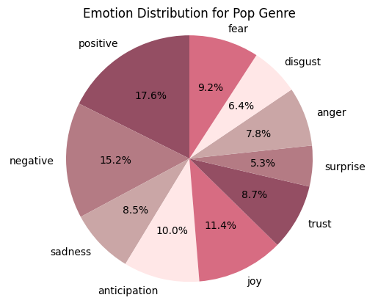
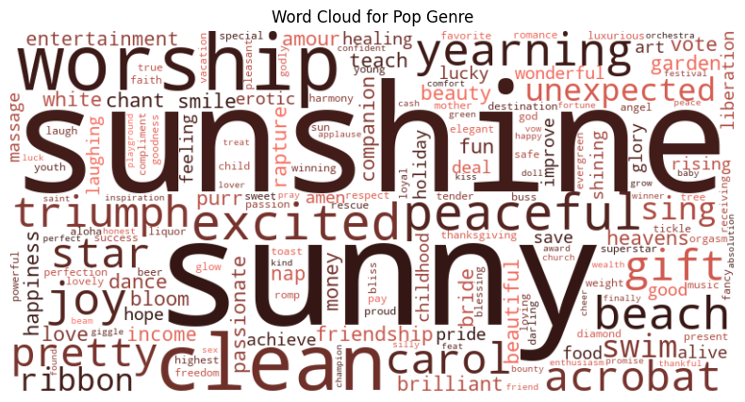
Lyrics Analysis by Genre-Pop

Slide 12
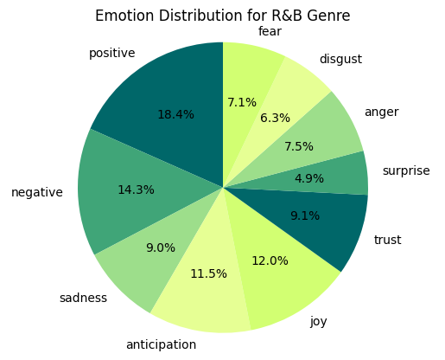
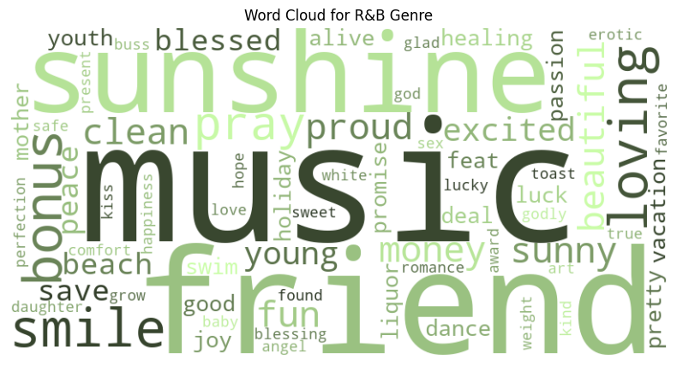
Lyrics Analysis by Genre-R&B

Slide 13
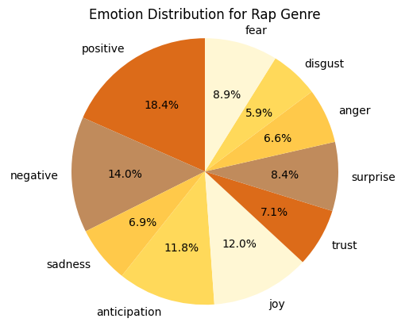
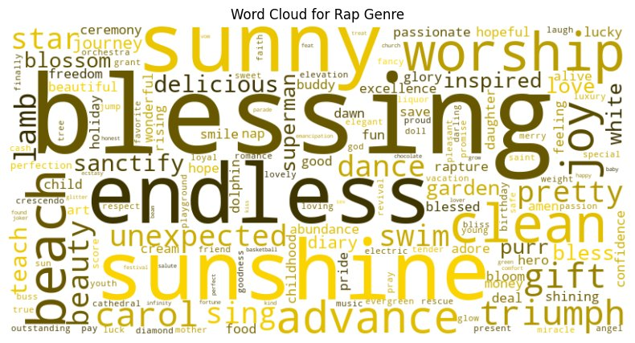
Lyrics Analysis by Genre-Rap

Slide 14
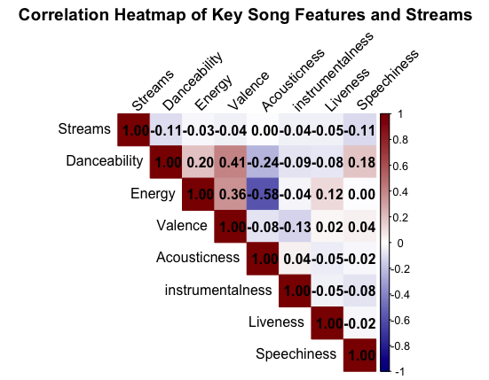
Correlations between Features and Populatity
Songs with higher danceability and energy show a weak negative correlation with popularity.
Danceability: Suitability of the song for dancing.
Valence: Positivity of the song’s musical content.
Energy: Perceived energy level of the song.
Acousticness: Acoustic sound presence in the song.
Instrumentalness: Proportion of instrumental content in the track.
Liveness: Presence of live performance elements.
Speechiness: Amount of spoken words in the song.

Slide 15
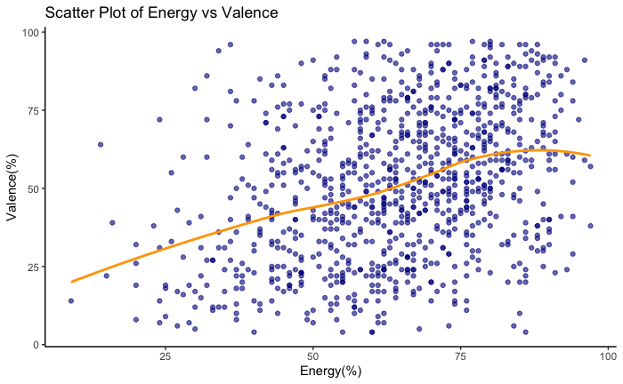
Trends between the Energy and Valence:
Positive Trend
Correlation: 0.36
Danceable songs tend to sound more positive.

Slide 16
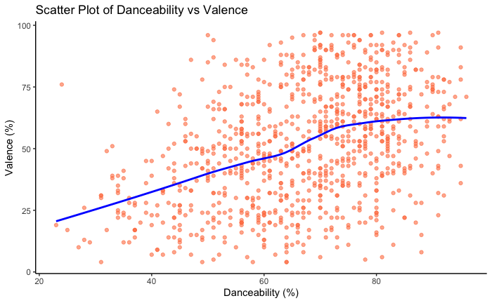
Trends between the Danceability and Valence:
Positive Trend
Correlation: 0.41
Danceable songs are also likely to be perceived as positive.

Slide 17
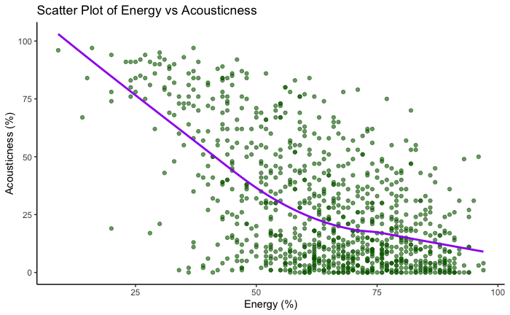
Trends between the Energy and Acousticness:
Negative Trend
Correlation: -0.58
More energetic songs tend to have fewer acoustic elements.

Slide 18
These insights can be utilized to make informed decisions in music production, selection for playlists, or even marketing strategies targeting specific listener preferences.

Slide 19


Example: Creating a "High-Energy Workout" Playlist
Scenario: A streaming service aims to curate a playlist that enhances workout experiences by boosting energy and mood.
Use of Insights:
Energy and Valence: Positive correlation suggests selecting songs that are both energetic and feel-good to uplift and energize listeners during workouts.
Danceability and Valence: Positive correlation indicates inclusion of danceable, upbeat songs to make workouts enjoyable and engaging.
Energy and Acousticness: Negative correlation guides avoiding acoustic tracks in favor of more electronic and pop songs that match the high-energy workout vibe.
Song Selections:
"Titanium" by David Guetta feat. Sia for its empowering, high-energy beat.
"Can't Stop the Feeling" by Justin Timberlake for its infectious, upbeat rhythm.
"Uptown Funk" by Mark Ronson feat. Bruno Mars, known for its dynamic energy and danceability.
Marketing Approach: Promote the playlist as the ultimate workout companion, targeting fitness enthusiasts seeking motivational and energizing music.

Slide 20
Conclusion
Music attributes and popularity
The fusion of music and emotion

Slide 21
Limitation​
Data limitations and sample diversity challenges
Scope of analysis and limitations of prevalence measures
Sentiment analysis of lyrics is currently limited to English, which may introduce some bias.

